Slide 1






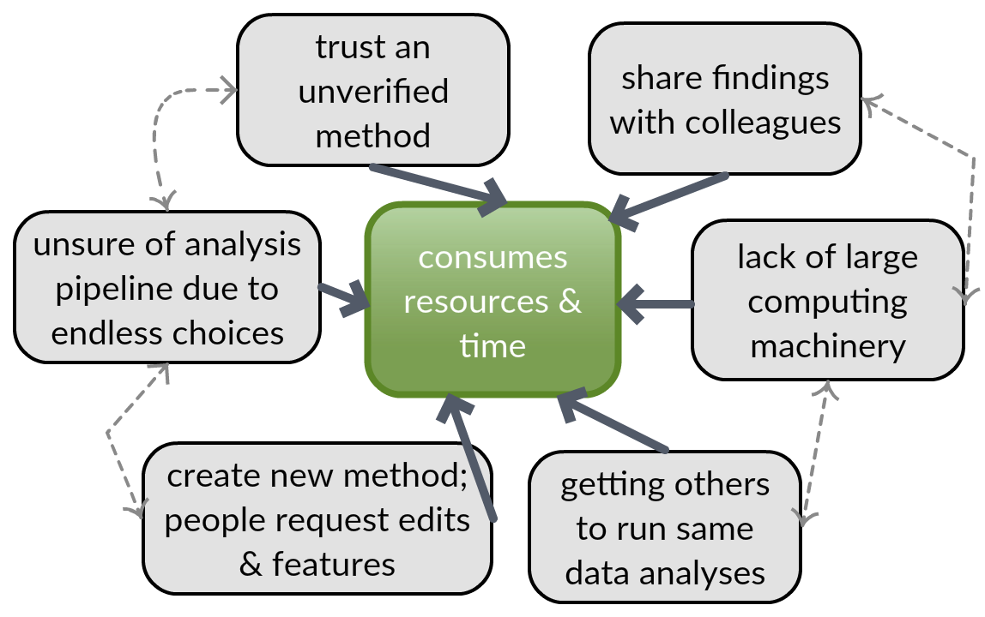
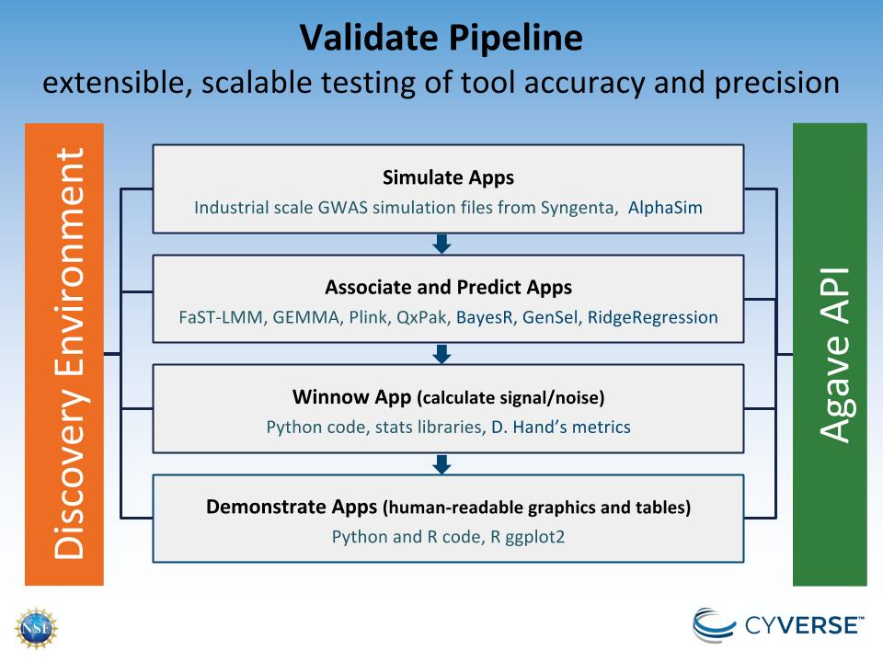

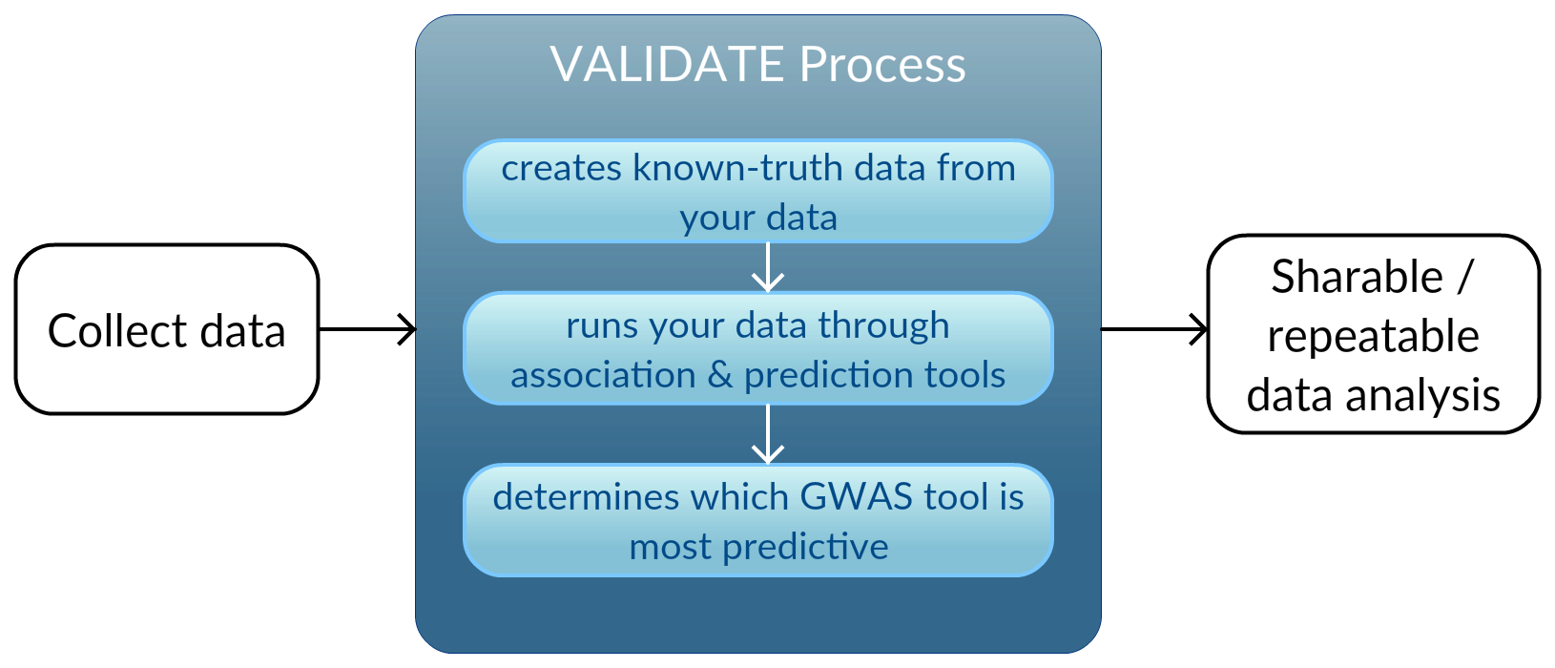
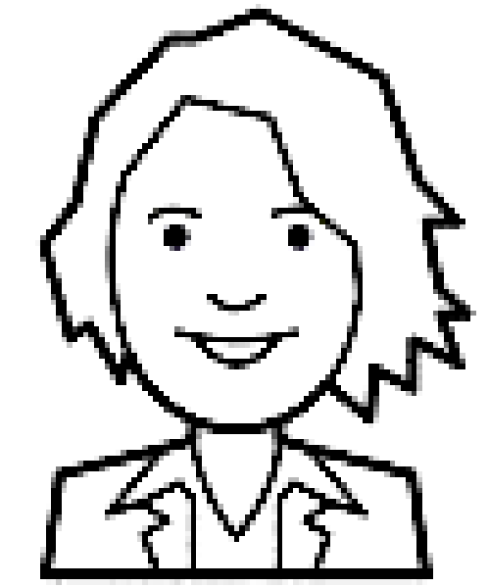
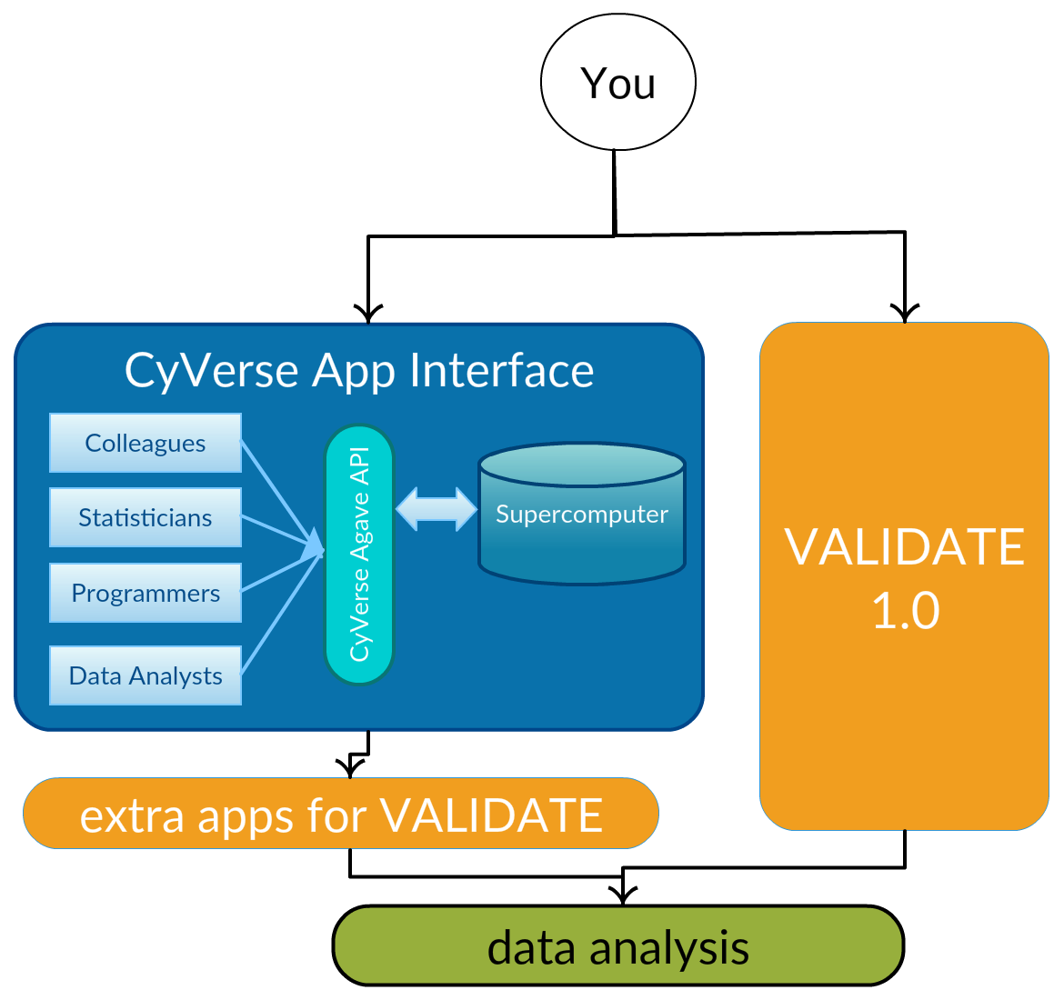
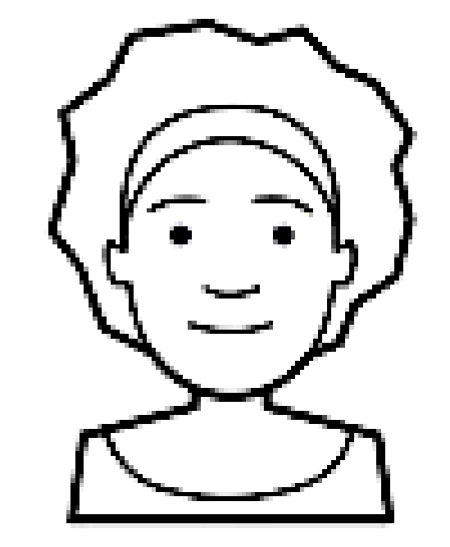

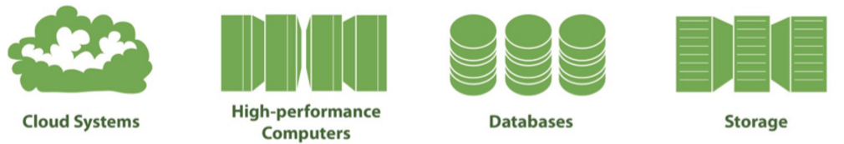


VALIDATE on the CyVerse cyberinfrastructure: scalable testing of the accuracy and precision of association and prediction software
Stapleton, Ann E., Xiao, Yunkai, Chaung, Danielle, Cockerill, Sierra, Talley, Stephen P., Buck, Samuel W., Landers, Dustin, and CyVerse. University of North Carolina Wilmington, CyVerse.org
Transforming Science Through Data-driven Discovery
CyVerse is supported by the National Science Foundation under Grant No. DBI-0735191 and DBI-1265383.
Problems When Analyzing Data
VALIDATE Workflow
Simulate: Simulation software such as AlphaSim outputs the known-truth phenotypes for a set of populations
Associate and Predict - GWAS tools:
FaST-LMM¹: designed for large data sets, more specifically used to test all SNPs in a data set for statistical significance
GEMMA²: A GWAS analysis tool specializing in bayesian mixed models and variations thereof
QxPak³: A versatile statistics package for in statistical genomics and quantitative trait locus (QTL) analyses.
BayesR⁴: high-performance and computationally demanding association and prediction method
Winnow: Tool that evaluates other GWAS tools
Demonstrate: Produces human-readable visual output from the results files of Winnow
“Today we are in the age of team science. It's very rare that one person does the whole thing. How do you work as a team so the data, the computation, all comes together? If it's in the CyVerse cyberinfrastructure, you can connect data and applications. You don't have to do anything extra.”
– Nirav Merchant, CoPI of CyVerse
All code documented and tested, freely available.
Tutorial for whole pipeline in place, http://validate-10.readthedocs.io/en/latest/
External alpha testers in place, plan in place for beta testers and future maintainers
What is VALIDATE?
User Scenarios
Conclusions
s
The CyVerse data analysis workflow, VALIDATE, lets you test the accuracy and precision of genotype-to-phenotype association and prediction applications. This is done using existing or your own custom known-truth simulations -- which have large numbers of files or large numbers of iterations and thus substantial computational demand.
Breeding Graduate Student |  | Changed parameters on a simulation tool to match their experimental design Ran simulation and association using Validate workflow Used optimal association tool settings for analyzing data
Statistician |  | Created a new method for association installed & shared via Agave Installed via Agave because it won’t run on a laptop Compared their method with 4 other existing methods for true and false positive rates using the Validate workflow
Data Analyst |  | Wrote scripts to determine the sensitivity of combinations of parameters to share with graduate students in their lab Installed new methods from the literature via Agave
We created a pipeline with current association and prediction apps and maximum computer capability so you won’t need to do this yourself. When you want to add an app, it will be ready for you.
Our Winnow app is used to evaluate the other tools in your pipeline. Given the "known truth" of a simulation data set, we output a series of fit statistics to determine how a method was useful in analyzing specific datasets. We support a range of simulation software and stored files, with several pre-installed association and prediction applications.
Resources We Use & You Have Access to
Since the analysis are run on the XSEDE computer systems, the computational demand for your simulations will scale up as your needs increase. We especially encourage you to make your new apps public and share them through CyVerse,
so that people who adopt your method can run it quickly and easily.
Advantages
Get it Done |  | Collaborate with students and colleagues Seamless connection between Data Store and apps Guaranteed correct data transfer at maximum speed
Reproducibility |  | Make data, workflows, and analyses available in a public set of apps Access previous software versions and manage dependencies
Productivity |  | Running analyses through Agave is scalable, extensible, sharable Many advantages when you have a project across multiple universities “Mastermind” don’t download
References
1. Lippert, C., Quon, G., Kang, E. Y., Kadie, C. M., Listgarten, J., and Heckerman, D. (2013). The benefits of selecting phenotype-specific variants for applications of mixed models in genomics. Sci. Rep. 3. doi:10.1038/srep01815.
3. Perez-Enciso, M., and Misztal, I. (2004). Qxpak: a versatile mixed model application for genetical genomics and QTL analyses. Bioinformatics 20, 2792–2798. doi:10.1093/bioinformatics/bth331.
2. Zhou, X., Carbonetto, P., and Stephens, M. (2013). Polygenic Modeling with Bayesian Sparse Linear Mixed Models. PLoS Genet. 9. doi:10.1371/journal.pgen.1003264.
4. Moser, G., Lee, S. H., Hayes, B. J., Goddard, M. E., Wray, N. R., and Visscher, P. M. (2015). Simultaneous Discovery, Estimation and Prediction Analysis of Complex Traits Using a Bayesian Mixture Model. PLoS Genet 11, e1004969. doi:10.1371/journal.pgen.1004969.

